Slide 1
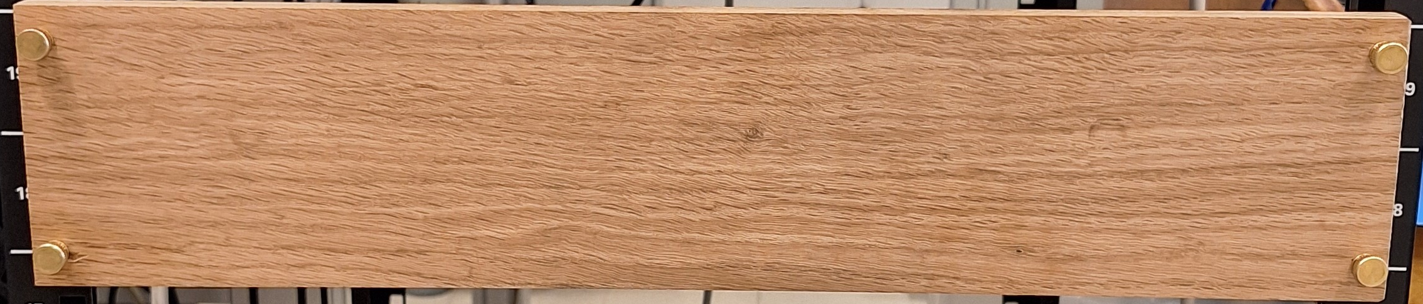
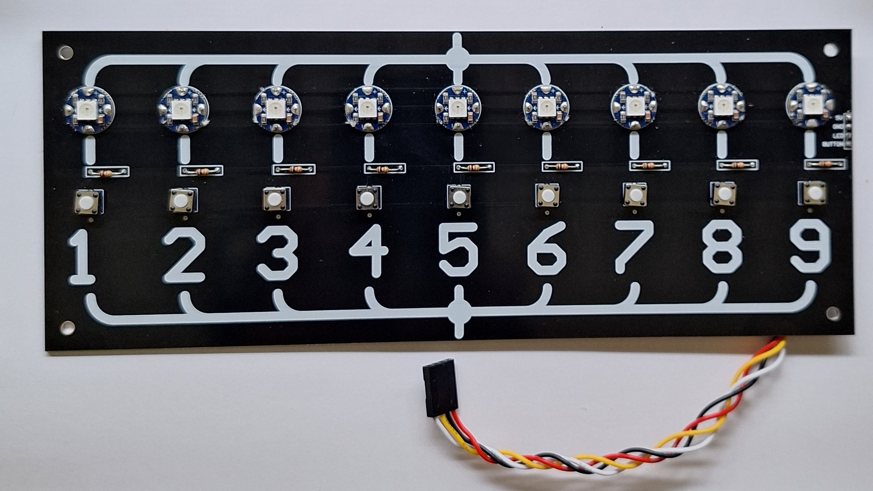
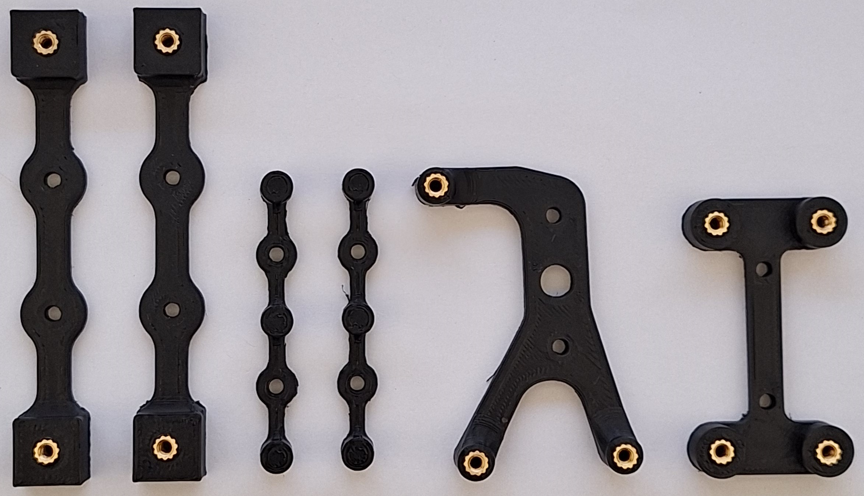
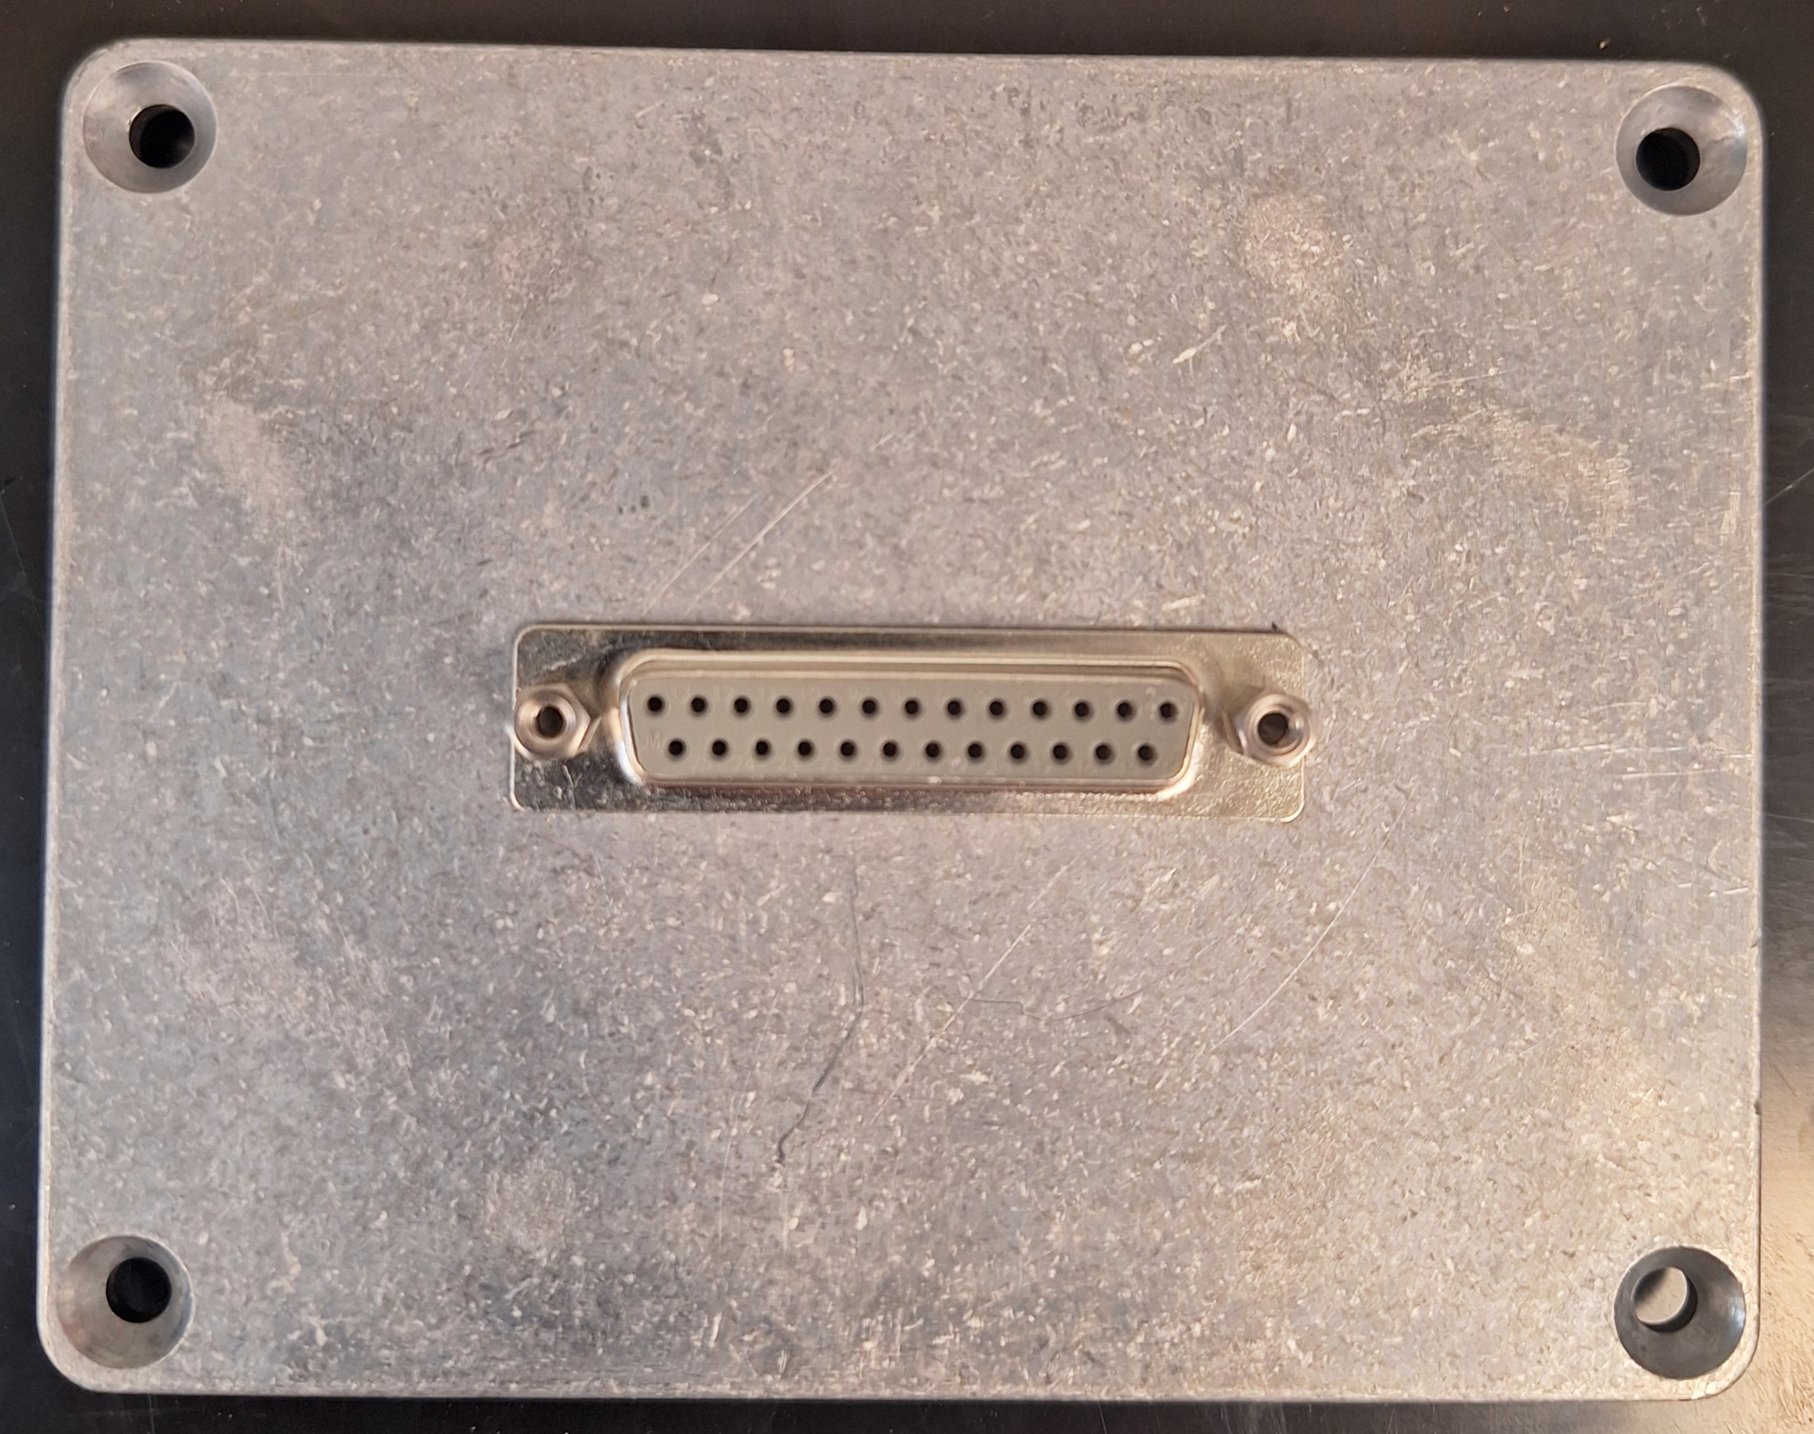
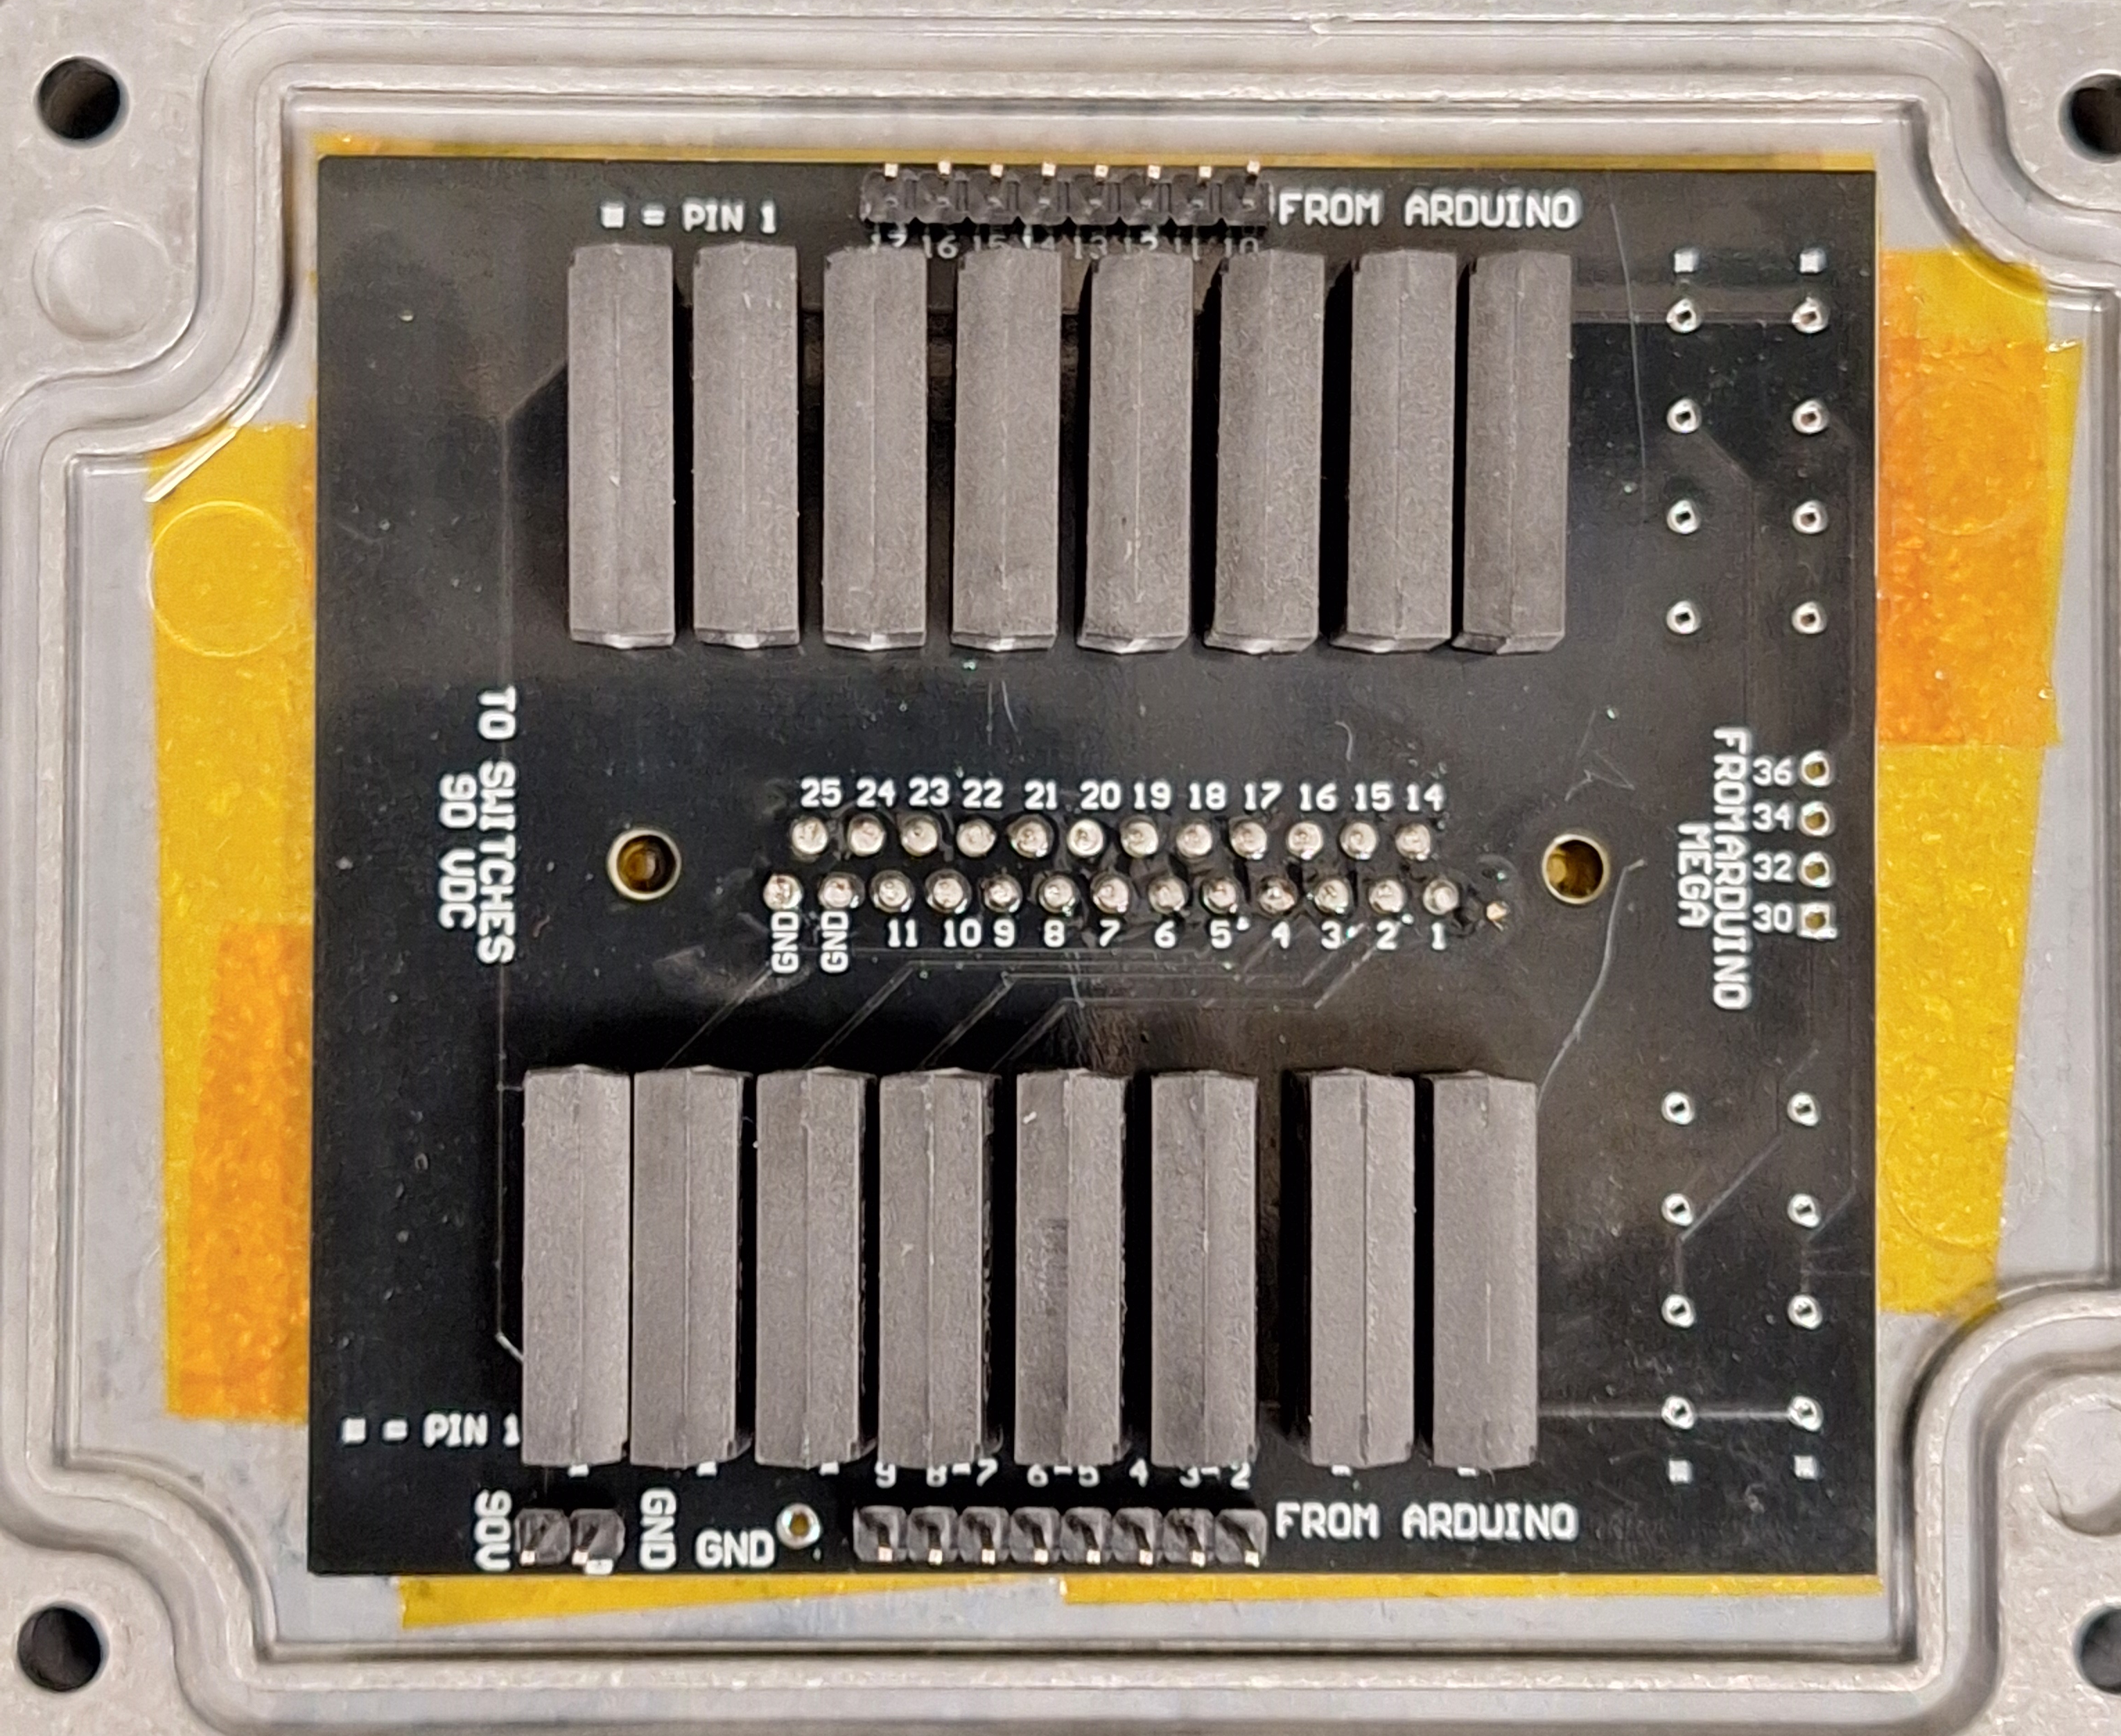
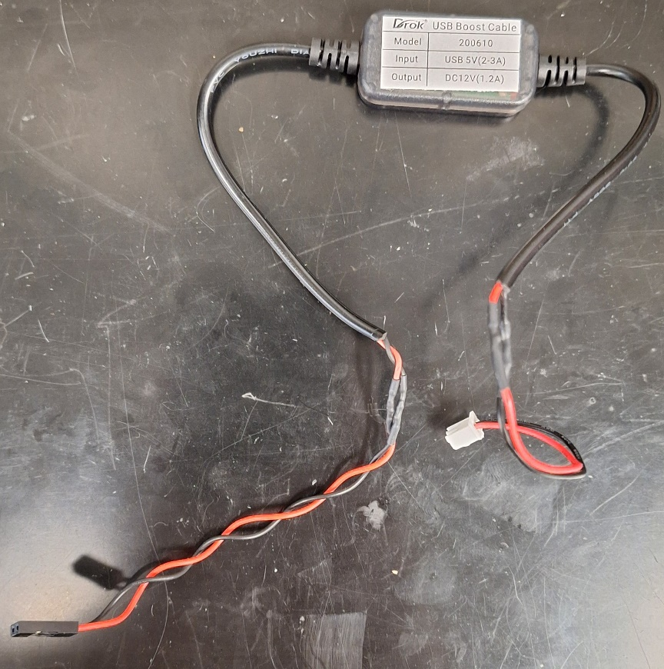
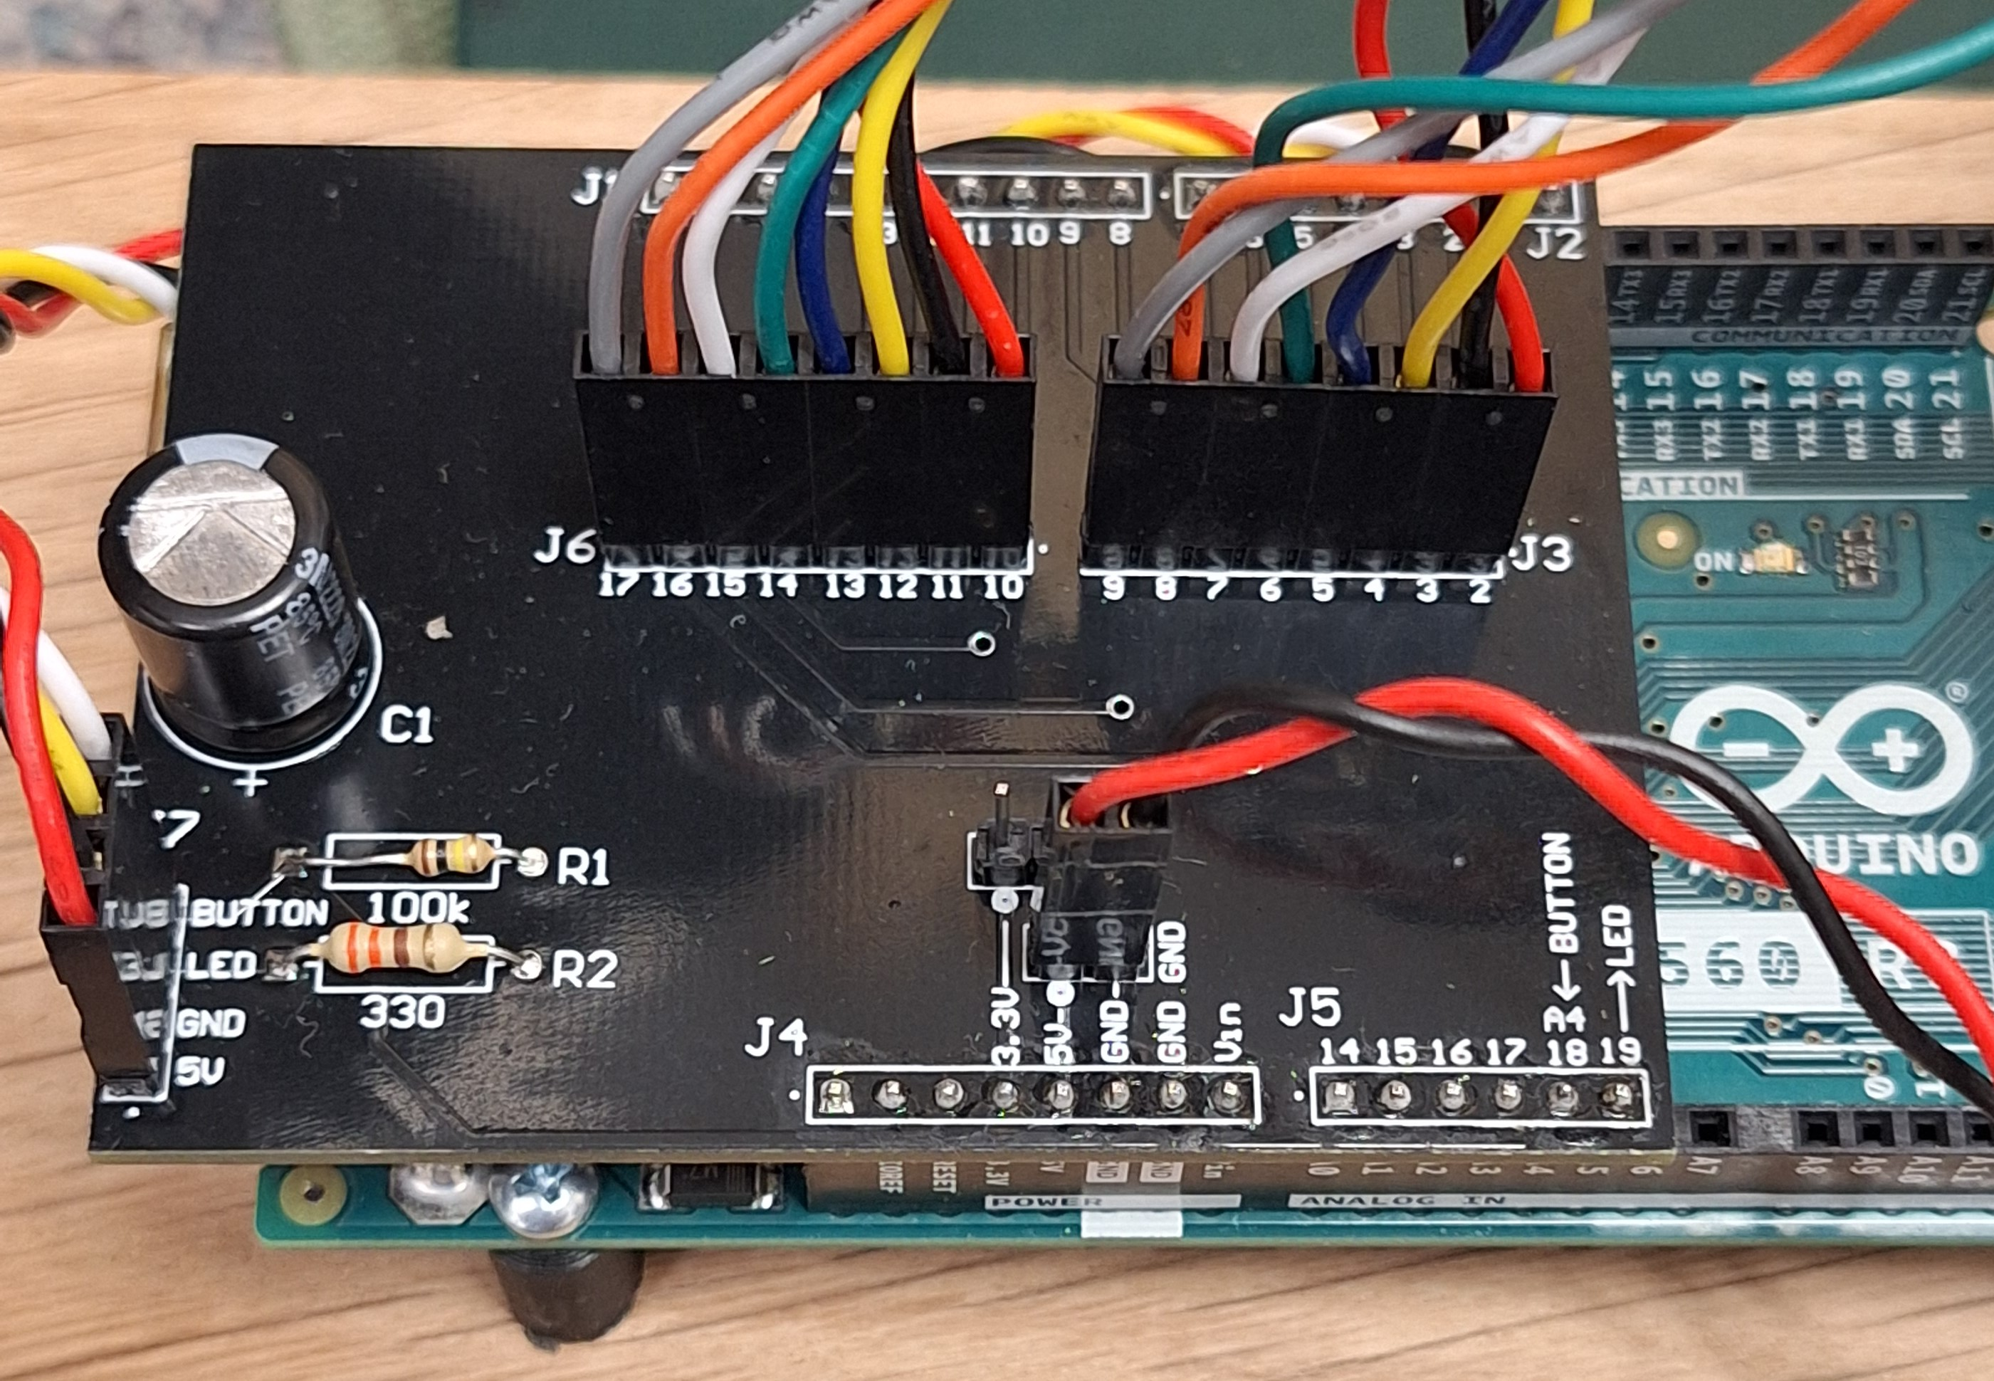
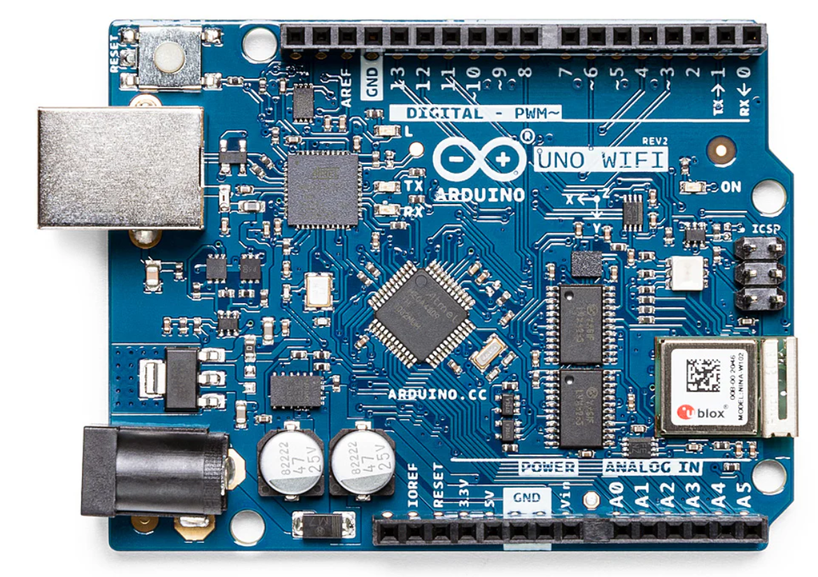
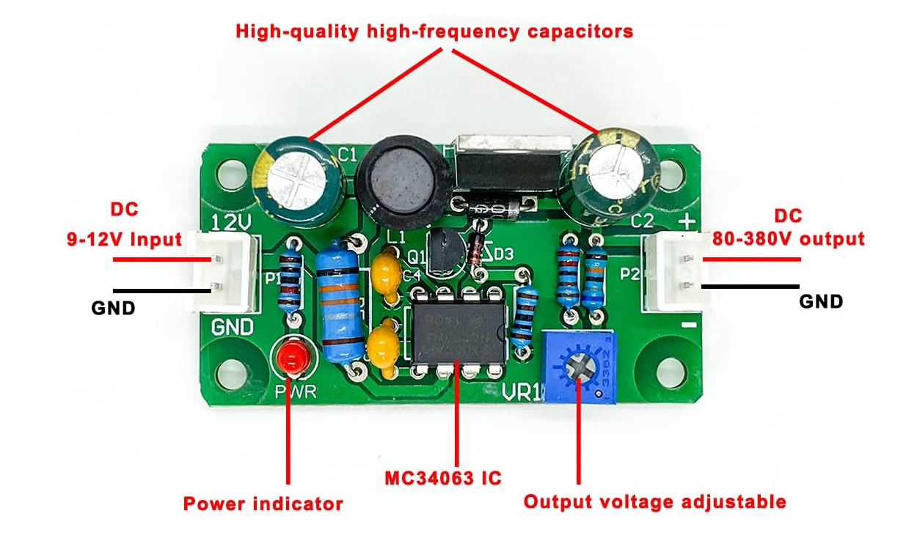
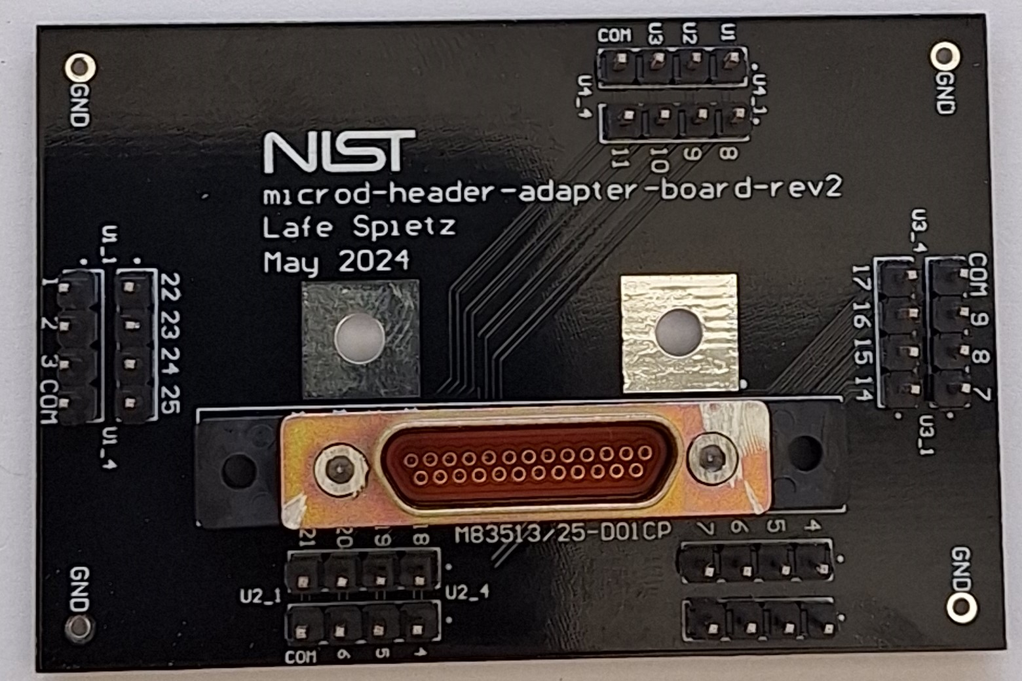
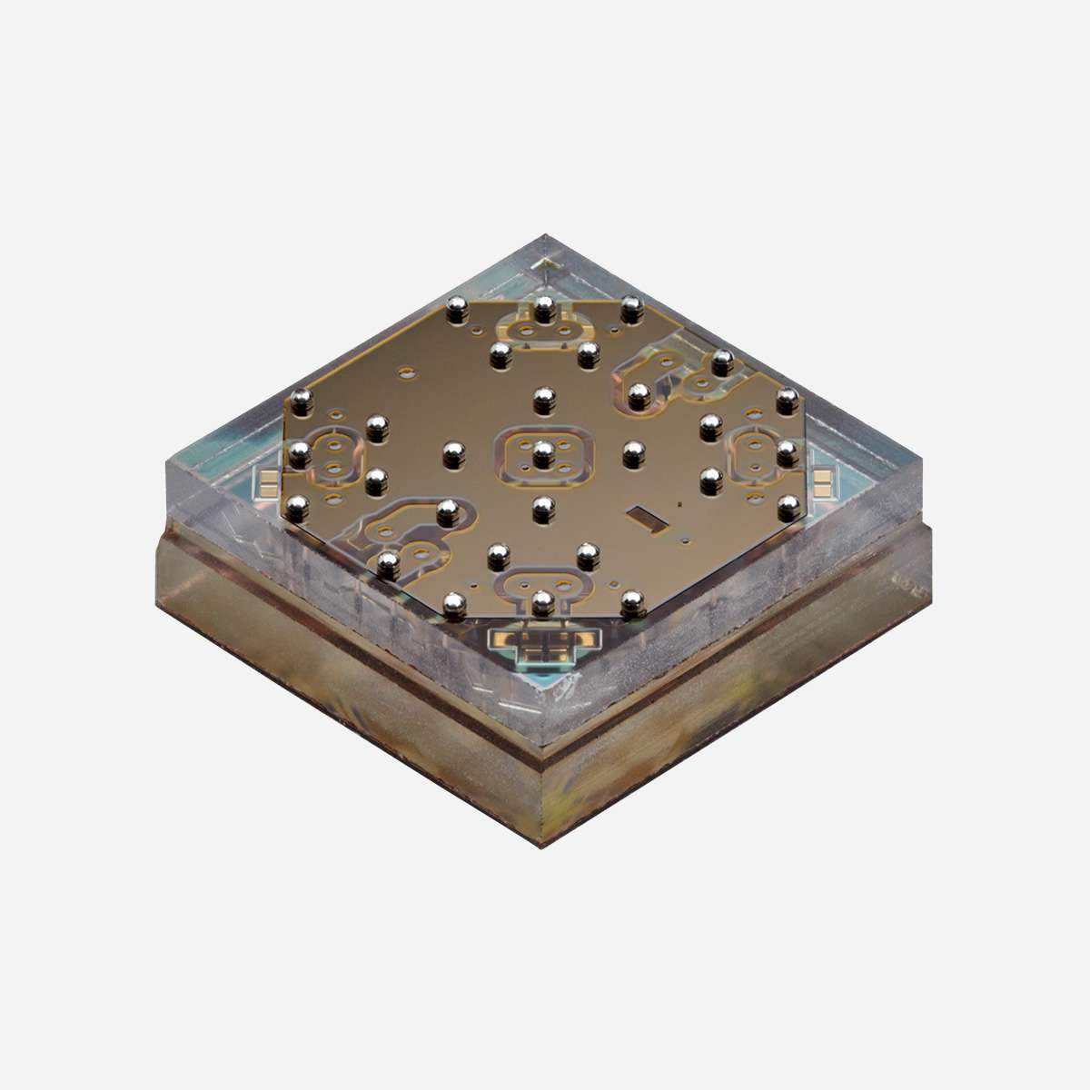




Wood Boards
3d printed parts
Front Panel Boards
90 V Control Lines
90 V Power
5 V Power
NeoPixel Control
Button Signal
Bud Box
DB25 Relay HV Control
90 Volt Boost
Shield
Arduino UNO
90 V Control Lines
5V Control Signals
90 V Control Lines
MEMSDuino
Cold MicroD Breakout
RF MEMS Switches
0.01 kelvin Dilution Refrigerator

